Slide 1
Controlling the Spread of Disease
Syllabus:
Management strategies are used to control the spread of infectious diseases, including:
  quarantine
  immunisation – herd immunity
  disruption of pathogen life cycle
  medications – antibiotics and antivirals
  physical preventative measures
International cooperation and communication are needed to evaluate the risk of the spread of disease, including the emergence of new viral diseases (SHE)
Quarantine measures protect Australia’s agriculture industry and environment against the influx of disease-carrying materials and organisms in the face of increasing global trade and travel (SHE)
For each of the 10 diseases, describe the management strategies that are employed to effectively control the spread of the disease
Explain why International cooperation and communication are necessary to reduce to risk of the spread of diseases
Describe the Quarantine and Biosecurity measures implemented at the International and state borders as well as within the state to help control the spread of disease and protect Australia’s environment and agriculture
Biology WA UNITS 3 & 4
Reading
Chapter 14
Questions
Set 14.1 pg. 472 Q 1-5
Set 14.2a pg. 474 Q 1-3
Set 14.2b pg. 477 Q 1-4
Set 14.2c pg. 481 Q 1-3
Set 14.2d pg. 483 Q 1-4
Set 14.2e pg. 494 Q 1-5
Set 14.3 pg. 498 Q 1-3
BIOZONE
The Nature of Pathogens: 89, 90, 103
Essential
Question:

Slide 2
Controlling the Spread of Disease
Topic Question 1: Define the terms novel and emerging diseases and state how the World Health Organisation (WHO) helps to evaluate risk of the spread of emerging diseases
Term | Definition
Novel Disease
Emerging Diseases
Read page 470 of Biology WA ATAR Units 3 & 4 and answer the following:
State the 3 categories of Emerging diseases
Examples of emerging diseases
Why is the WHO and why is it necessary in preventing/minimising the spread of emerging diseases
How does the WHO combat the spread of disease

Slide 3
Topic Question 2: Explain why an international team is required for managing infectious diseases. Why can’t Australia manage diseases effectively without international communication & cooperation?

Slide 4
Topic Question 3: Some epidemics have well-established control measures, yet they remain a threat for many individuals for a variety of reasons. What do you think are some of the reasons for this?
Topic Question 4: Define the term epidemiology and state its importance

Slide 5
Topic Question 5: Describe how physical preventative measures can control the spread of disease
Type of Physical Preventative measure | Description | Example of how the measure could control the spread of a specific disease
Hand washing
Use filtered clean water & food
Sanitation
Sneeze & cough into elbow
Barriers

Slide 6
Topic Question 6: Define the terms Quarantine and Biosecurity
Quarantine
Biosecurity
Topic Question 7: Read pages 473 – 474 Biology WA ATAR Units 3 & 4, When travellers enter Australia from overseas, they are required to declare all plant and animal matter that they have brought with the. Explain why

Slide 7
Biosecurity Surveillance & Quarantine in Australia
International
Interstate
Intrastate
Topic Question 8: There are three levels of Quarantine and Biosecurity adhered to in Western Australia (International, Interstate and Intrastate) for the protection of the agricultural industry and the environment. What measures are employed at each level

Slide 8
Topic Question 9: Describe how biosecurity measure in Australia have, to date, protected our bees

Slide 9
Topic Question 10: Define the following terms:
vaccination, immunisation, inoculate, immunity
Match the term to the correct definition below
Term |  | Definition
Vaccination |  | is to introduce a microorganism into (these are unweakened live pathogens)
Immunisation |  | is the term used for getting a vaccine which can either be administered by injection or taking an oral vaccine dose
Inoculate |  | is the protection from an infectious disease. If you are immune to a disease, you can be exposed to it without becoming infected
Immunity |  | refers to process of both getting the vaccine and becoming immune to the disease following the vaccination. This term is often used interchangeable with vaccination or inoculation
Topic Question 11: Explain how vaccination can help to reduce the spread of a disease

Slide 10
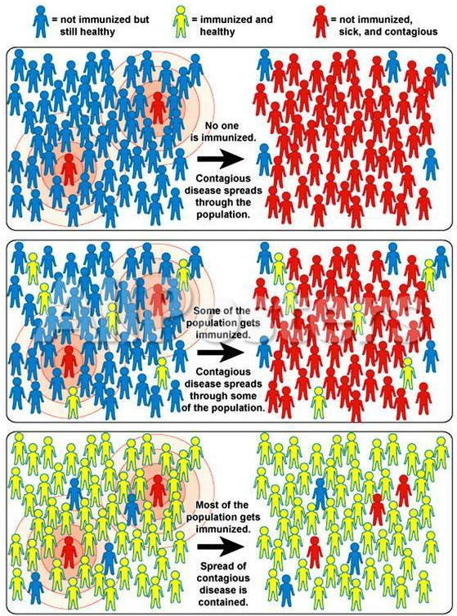
Topic Question 12: Effective vaccination programs are crucial to the maintenance of herd immunity. Explain the main principals of herd immunity

Slide 11
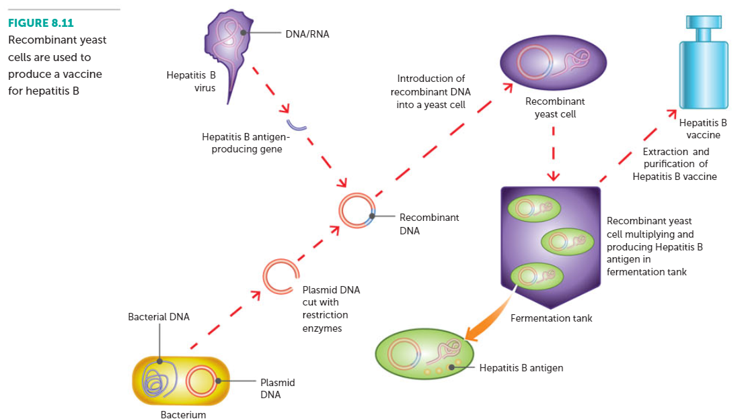
Topic Question 13: Explain why a different influenza vaccination is provided each winter
Topic Question 14: Suggest a reason why the emergence of variant strains of viruses occur in countries with large populations and high population densities
Topic Question 15: Using your knowledge of Recombinant DNA, describe how this technology can be used to make a vaccine

Slide 12
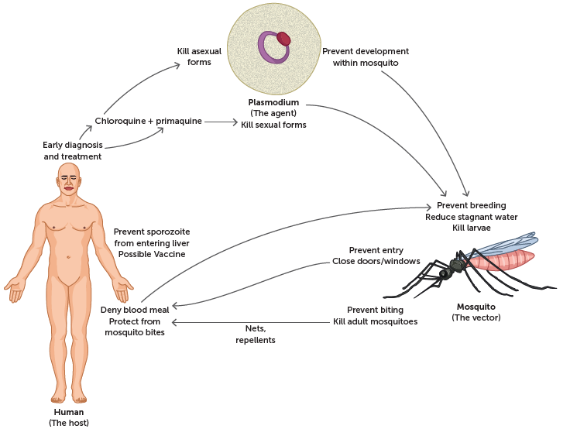
Topic Question 16:. Describe how disruption of the life cycle of a pathogen can control the spread of the disease the pathogen causes
Topic Question 17:. Describe how disruption of the life cycle of a pathogen can control the spread of Malaria

Slide 13
Topic Question 18:. Describe how medication can control the spread of disease
Medication | Pathogen medication will affect | Description of effect on the pathogen | Effect on the spread of the disease
Antibiotics
Antivirals
Antimalarials (quinine)

Slide 14
Sum it up!
Disease | Management Strategy
 | Quarantine | Biosecurity | Immunisation – herd immunity | Disruption of life cycle | Medications (antibiotics & antivirals)

Slide 15
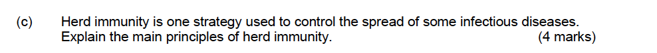
Practice Exam Questions

